Slide 1
OJT - How to Resolve Google Account Suspension Issue?

Slide 2
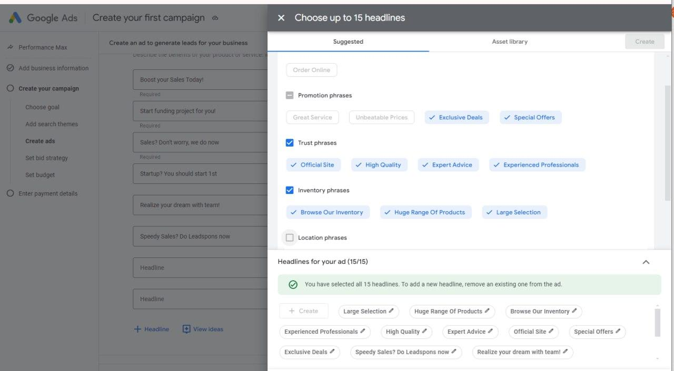
Google Ads Setting - Catchphrases
Catchphrases (30 words or less, without high profit $ and %)
Boost your Sales now with us!
Start funding project today!
Sales? Don't worry, we do now
Startup? You should start 1st
Realize your dream with team!
Speedy Sales? Do Leadspons now
Boost your Sales Today!

Slide 3
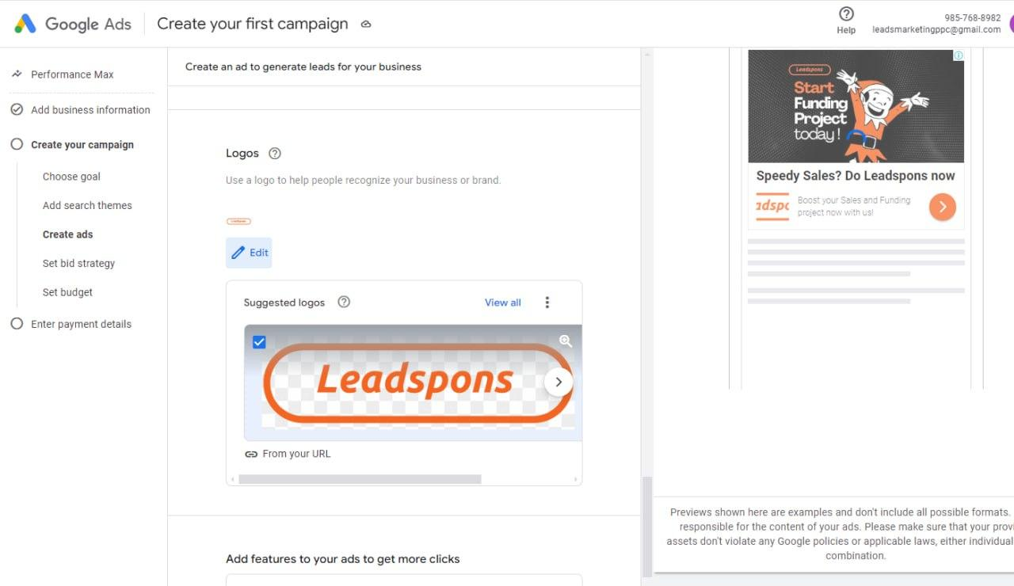
Google Ads Setting - Headlines and Logo
Headlines for Ads
Auto selection by Google
Square Logo
Go to Canva.com
Search for "Leadspons Square logo"
Download the logo

Slide 4
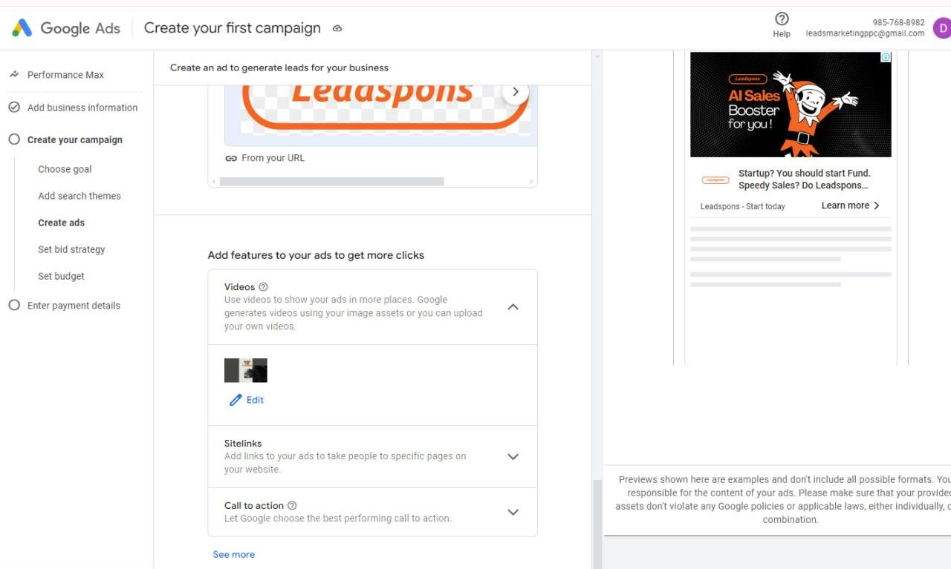
Google Ads Setting - Video Ads and Sitelink Text
Video Ads
Can be automatically fetched from the Leadspons YouTube channel
Sitelink Text
Fund Raising Campaigns
Start funding project today!
Sales? Don't worry, we do now
Website: https://leadspons.com

Slide 5
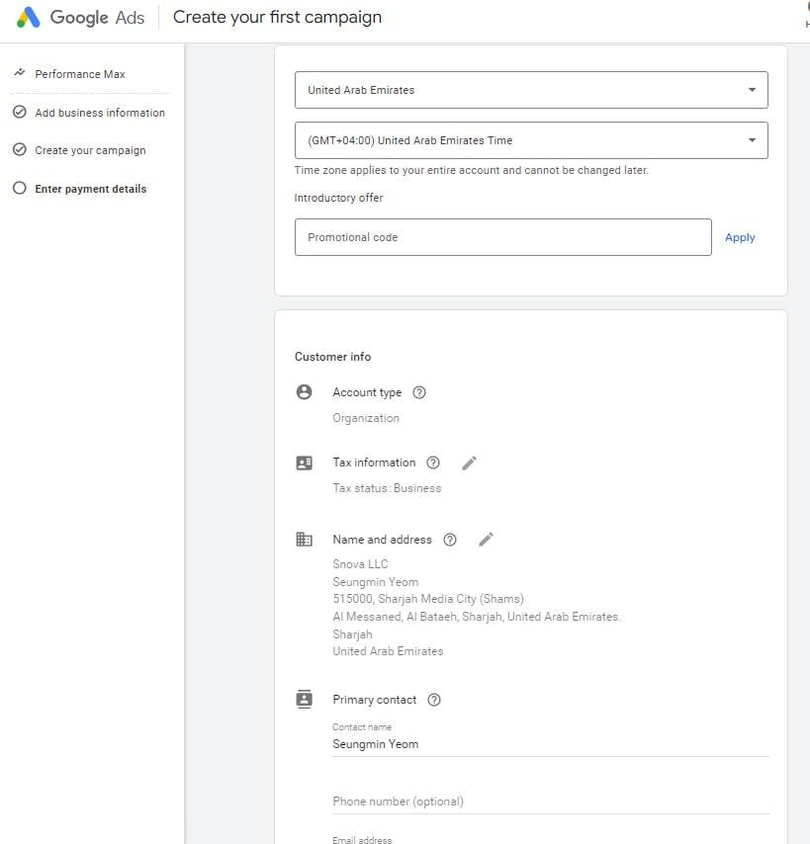
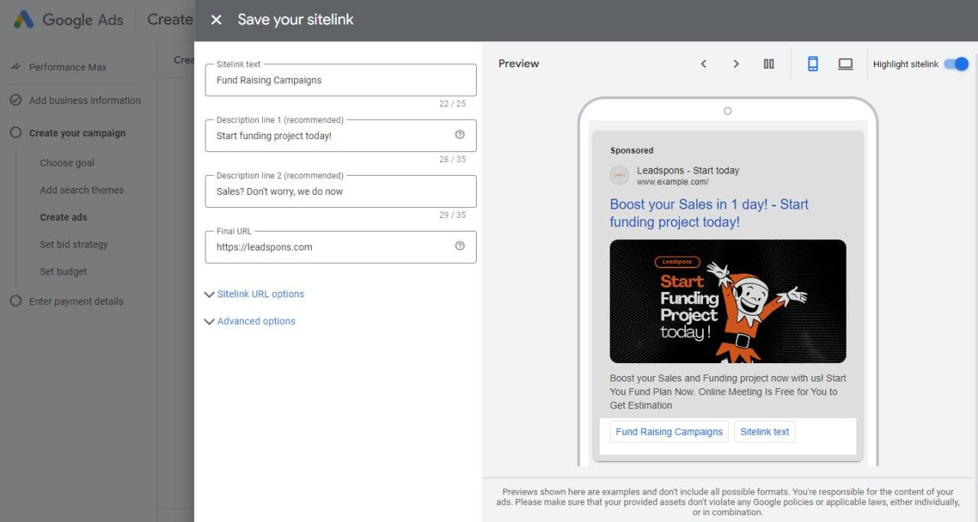
Google Ads Setting - Video Ads and Sitelink Text
Sitelink Text - Fundraising Campaigns
Start funding project today!
Sales? Don't worry, we do now
Website: https://leadspons.com

Slide 6
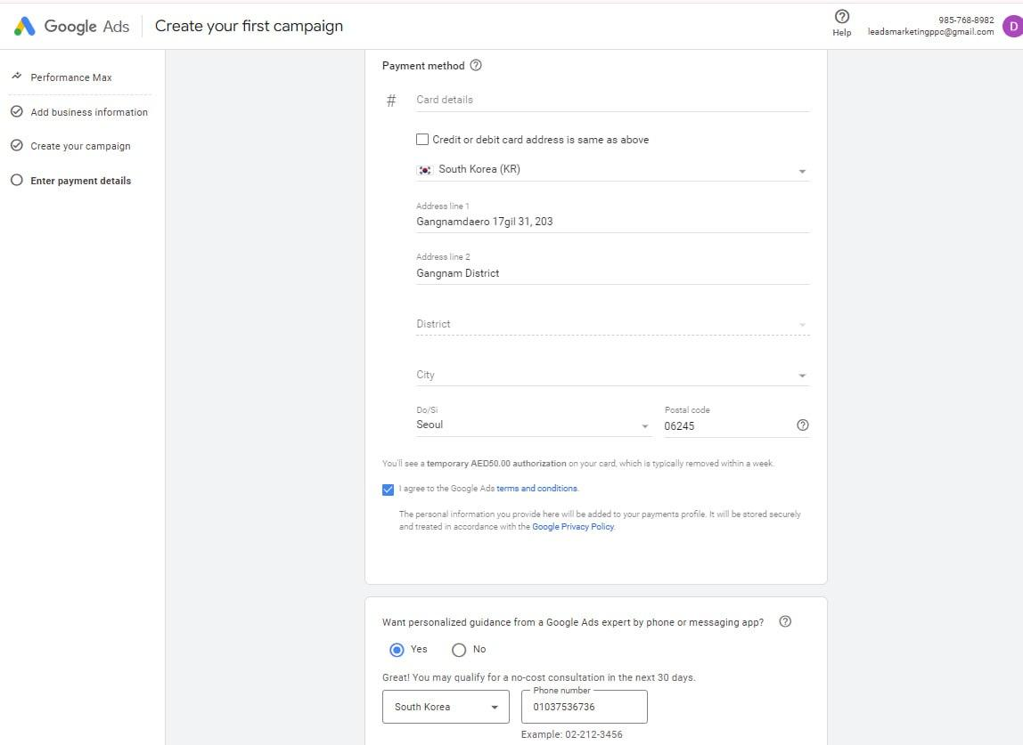
Card Information
Address
Gangnamdaero 17gil 31, 203, Gangnam District, Seoul, South Korea (Republic of Korea)

Slide 7
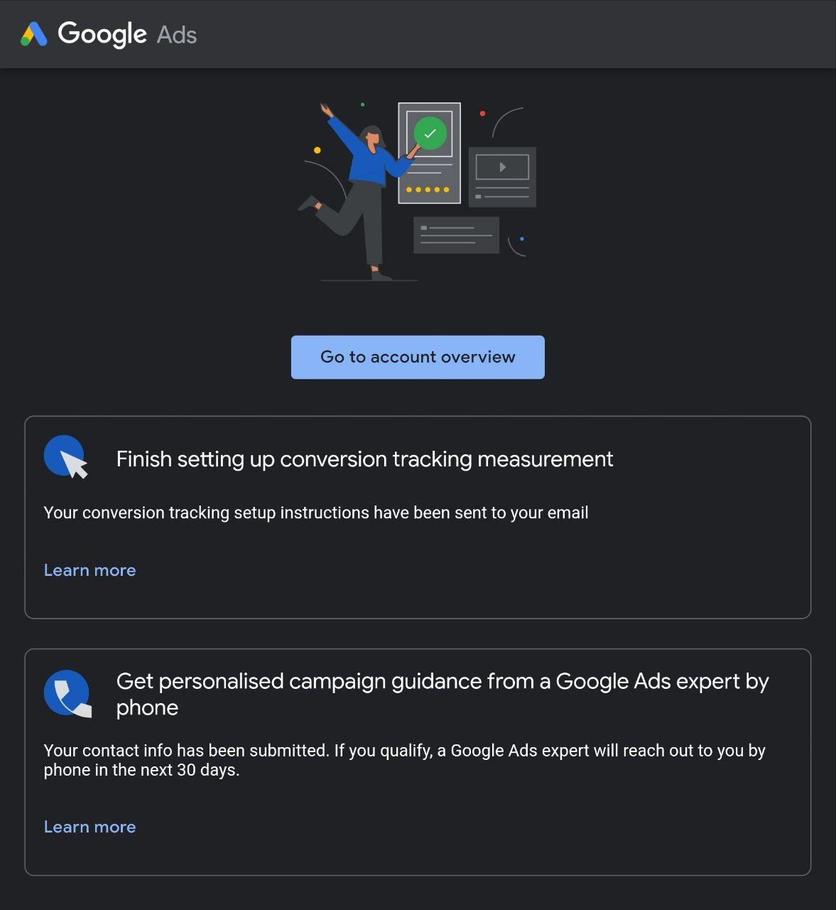
Tips for Setting Google Ads - Campaign Target Country
Campaign Target Country
Target: 🇺🇸 US, UK
Do not set: Crypto, Financial Phishing (%, $ on Google; Facebook Meta (Instagram) is okay)

Slide 8
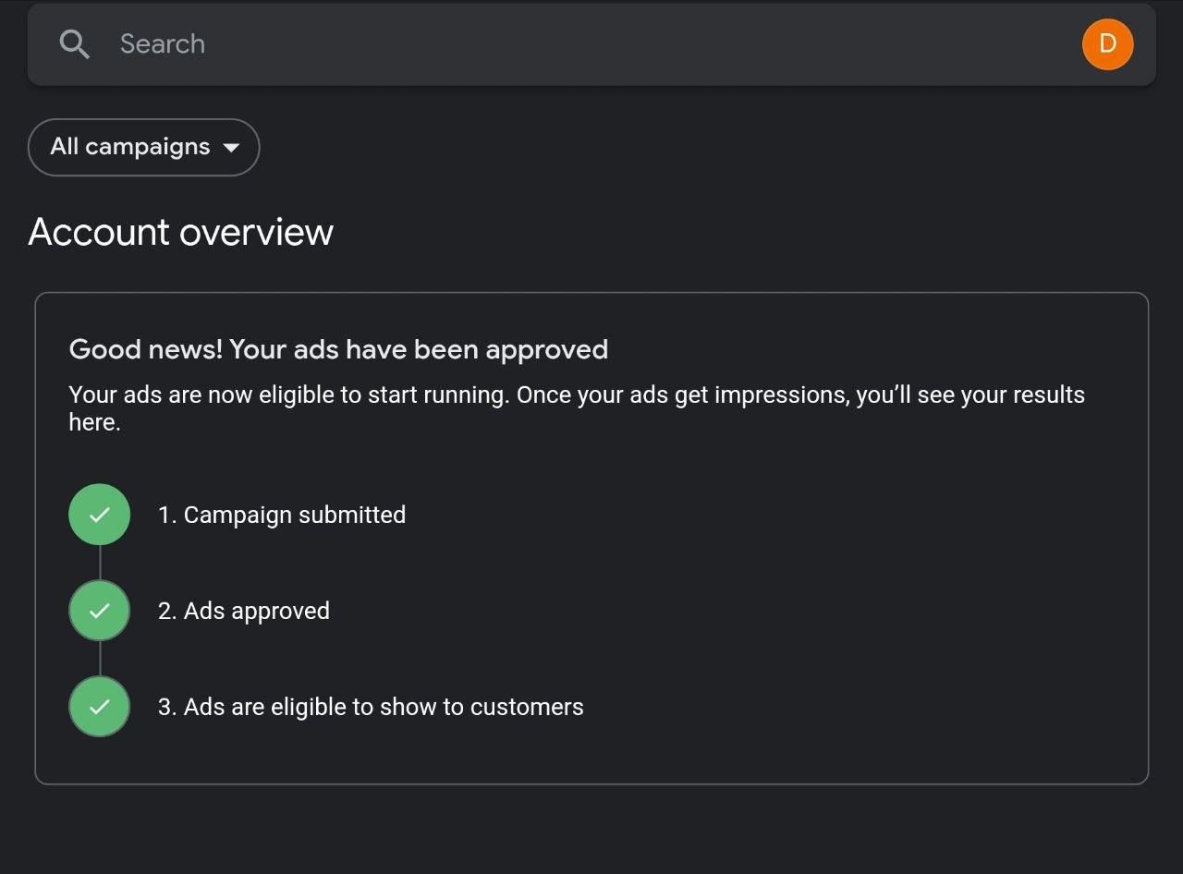
Tips for Setting Google Ads - Time Zone and Business License
Time Zone
Set: 🇺🇸 US, New York (to match customer time zone)
Business License
Same country business license may be required for the targeting country
Example: 🇺🇸 US Company Business License (ongoing process)

Slide 9
Tips for Setting Google Ads - Phone Number and Payment
Target Country Phone Number
Use: 🇺🇸 +1 66 166 97980 (Ed's US Number)
Payment
Choose "Individual" not "Organization" (using a private credit card, 🇰🇷 South Korea, the country does not matter)
Cardholder name should be the real name

Slide 10
How to Resolve Google Account Suspension Issue?
Guide from Google Expert (Google Partner) for Leadspons
New Google Account
A new Google account is needed to set the ads manually
Use bank account for fiat charging, not a credit card
Non-Phishing Content
Avoid high profit % $ content
Credit Card Information
Do not use previous credit card info that has been used before

Slide 11
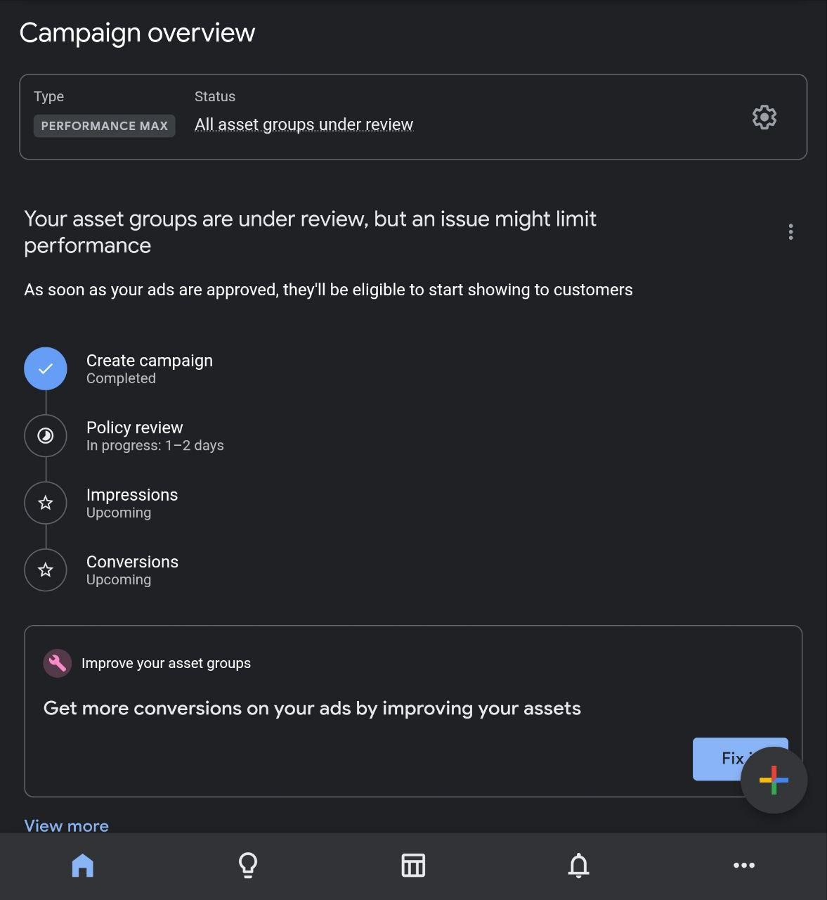
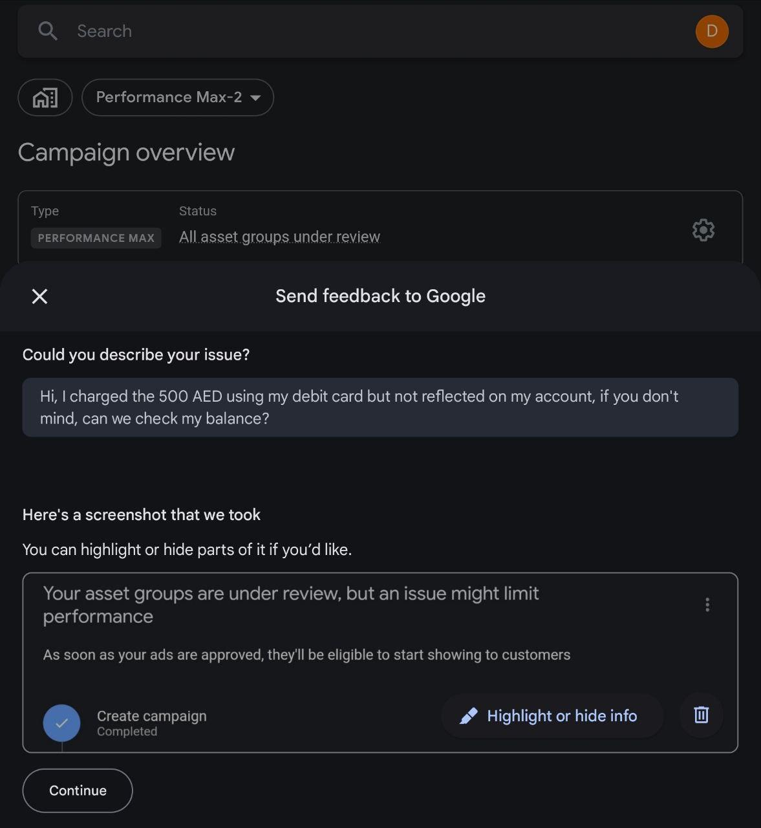
Post-Submission
All campaigns will be under review for 1-2 days
Wait for the review and consult with the Google Partner for any further issues

