Slide 1
Firing Process against Company Compliance and Designation
snovacapital.com

Slide 2
1. Materials : Microphone and Headphone
Designation but there is no result
[Firing detection from work performance against Compliance ]
1) everyone get the Payoneer salary (that's compliance)
2) He/She only requested additional charge for her own PayPal. Company should pay for more 15% charge for her regardless her work performance.(we requested continuously regardless company condition)
She requested to pay for more even though company has a expense for transaction fee.
[Bless them and Fire when we proceed the firing process]
HR and Auditor(Documenter) team when they proceed fire internal task owner and external task owner
When we fire the people give them compliment and let them know our company and task owner are not suitable even though task owner has a great skill we guess

Slide 3
1. Materials : Microphone and Headphone
don't just ask to your boss or teammate once you got the designation. Try to take initiatives) (don't waste company time commodity 2-3times with your asking without performance first)
Other people doing so well👍
After getting the designation, which cases are worst cases?
1) searchable in Google, but keep asking to boss or team mate? That's the worst question 👿
2) you can fill in the form with client or freely you can create the contents but you asking to boss or team mate?
That's the worst question 👿
3) got the designation but asking different questions about other projects?
That's the worst question 👿

Slide 4
1. Materials : Microphone and Headphone
[OJT for all team]
Daily Reminder for DSS (Daily Task Sheet)
Dear all,
I am writing to bring this matter to attention. This is very critical in terms of individual performances. I will be evaluating each performances and make decision.
Don't make me repeat twice.
1. @MominaUmer2231
Please announce to groupchat daily including this caution to follow the OJT onboarding process (following guides)
2. @rakhshimalik Once you clock in, check last night performance and report to me on each staffs who left without any task completion (everyday 0900-0930, don't miss it, this is your duty.)
3. @itxmedaniyal Let's begin training people with 360 learning in detail. Please give me all the access documents.
4. @andleeb12 Abeer Once you have been assigned with task, don't forget to fill in the info as much as you can first instead of just asking and leave. This is basic attitude.

Slide 5
1. Materials : Microphone and Headphone
Never leave the contents empty by just asking 'question and leave with nothing'.
1) There are plenty of resources!If you don't know, you can just search on google or chatgpt, and fill in the info instead of asking to your teammate.
2) Don't waste your teammate work time. Don't make company waste time and commodity because of your laziness.
Even children can search on Google. But if you can't do the simple task and keep asking your team mate or boss, boss would rather hire himself not desginating each personnel, don't you think?
3) This includes work ethics, if you are not lifting a single finger by yourself and allow others to do all the dirty work - that's a very bad work attitude.
@MominaUmer2231 @andleeb12
I have mentioned several times, why aren't you doing the HR and 360 learning continuously and allow staffs to leave after "just asking a question"?
@rakhshimalik this is a caution, please track who is only asking about the work and leaving without completion of work.(even though google search can be done in less than 5 mins. If you or someone else find these attitude, evaluate him or her with Penalty Caution. Once they get 5 times of Penalty caution in 1 week, HR will start the firing process

Slide 6
1. Materials : Microphone and Headphone
🎯[All team]
Don't ask people without time designation. Let teammare finish in minimum time as fast as they can. (If they didn't reply, please get the reply.
📷Until to get reply ask them every 10 mins when they can, auditor(HR) and C team will monitor every single 10 mins reviewing the Chat room🔍
Never forget to set the time limit at that day when you ask specific task. Don't forget to set the time limit when you ask to your team mate. (If designated task owner don't reply, that would be 15-20mins task automatically and affect designated task owner job review automatically by HR auditor)
👹Never leave the [1 single request sentences only] Put [time limit together]📅
Contents upload task never pass the 3-5 hrs. Please guide with the video all the time
📋If you ignore or don't make the due time(time limit), it affect your task review and minus(-) incentive because give the company uncertainty.
If you said yes to proceed the job or task but there is no result 3 times without any explanation or excuse, we do the firing process unfortunately
Don't forget about it just in case. Most of collegues are doing so well but sometime can possibly being the risk to Company

Slide 7
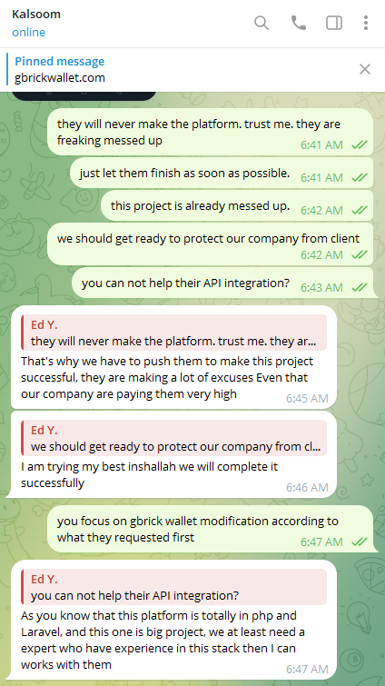
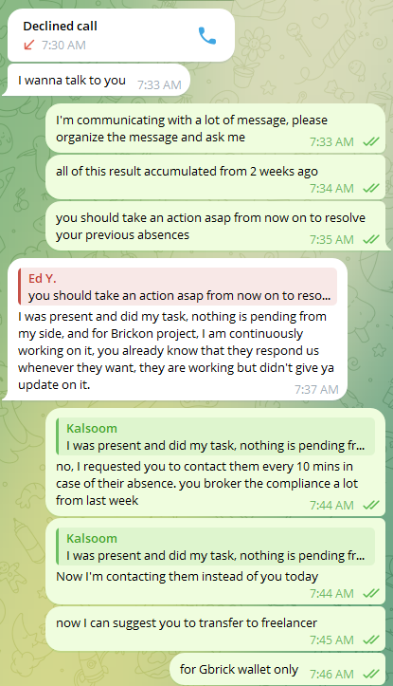
1. Materials : Microphone and Headphone

Slide 8
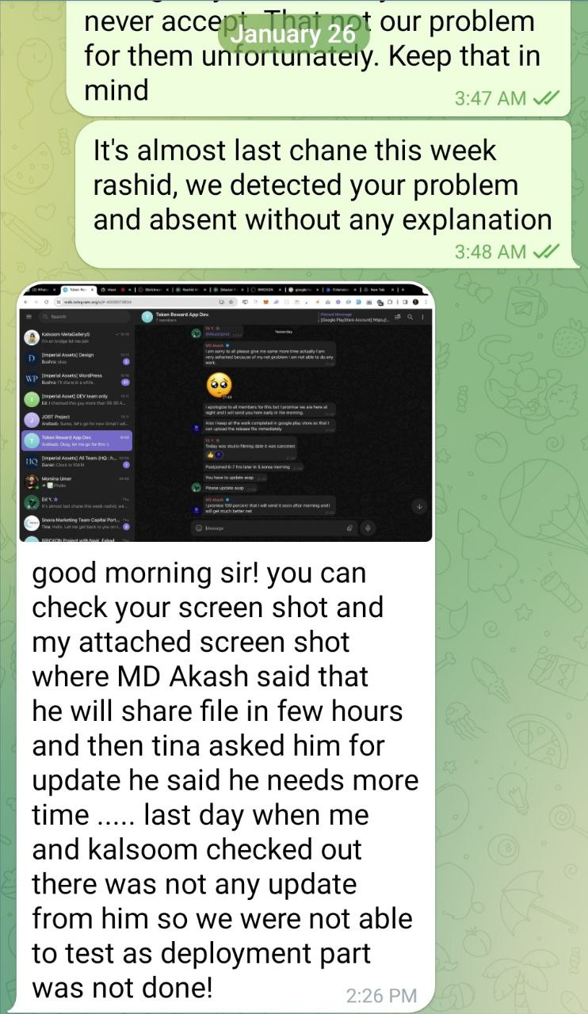
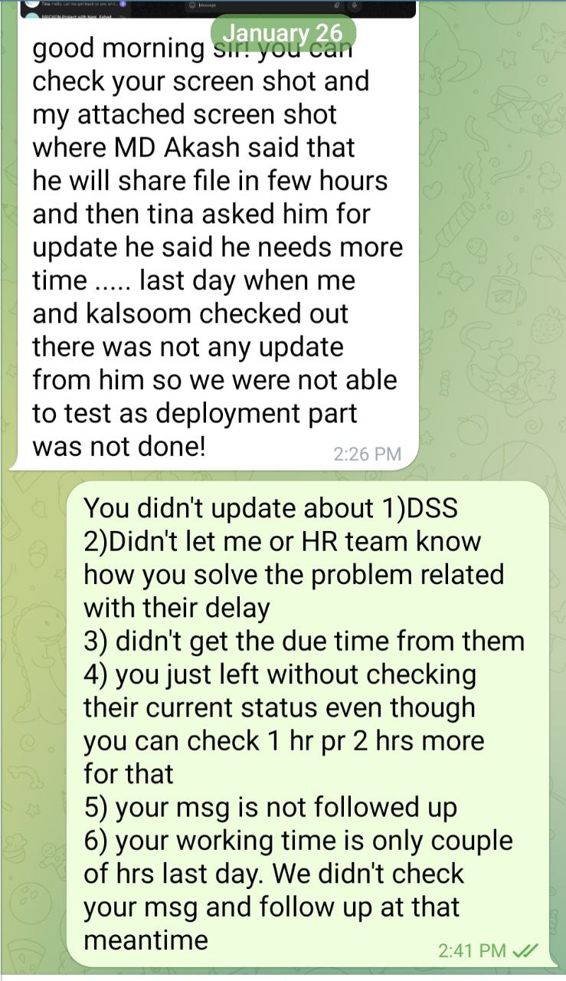
1. Materials : Microphone and Headphone
2) let them know about the reason why we got firing detection (they never change. Once we detect that, please announce them. Human never their change their mindset easily. Normally it take 5-10 yrs to change at least)
1) response after warning: Bad Excuse

Slide 9
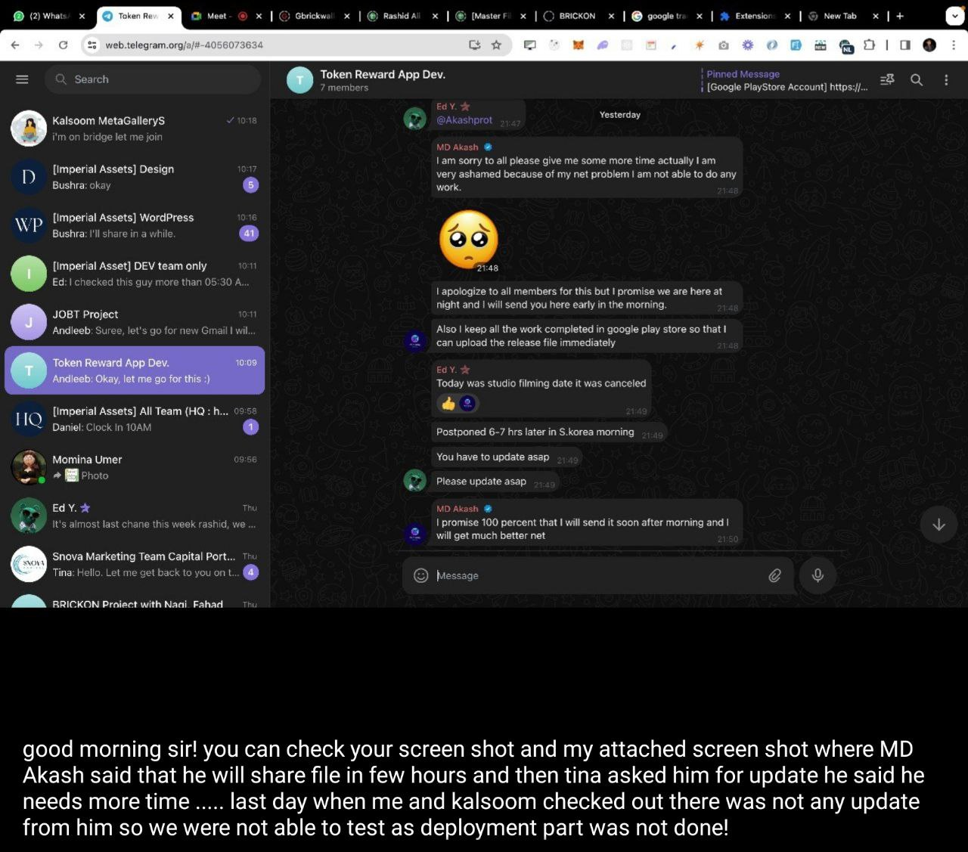
1. Materials : Microphone and Headphone
3)They are making a lot of excuse but finally CEO doing the PM instead of their work

