Slide 1
BD, D, M, C team
Sales Procedures (Daily Routine)
snovacapital.com

Slide 2
Contents to learn this lecture
Daily routine (In this Slides, you can learn following strategies)
(We will take an exam with test. So memorize all process as much as you can)
1. Let's learn how to connect with Make.com or order to automatic setting with automation team today
2. we have to set these notification process to client
3. please announce current process to client with any kind of info (Audit, Marketing, setting, communication with exchange or SEO automation and etc)
4. Accounting(Estimation) propose to client (fee invoice sending) process should be done by tomorrow
5. Marketing inbound process for partnerscan.org will be arranged
6. OJT Folder directory instruction (+360 learning) should be proceeded (let's do it tomorrow in the zoom)
7. Flickrz, Bittok, Brickon, Findex wordpress profit sharing system will be launced by tomorrow with my wordpress(let's do it tomorrow) 60 mins) https://www.youtube.com/watch?v=7jTcmctOY1Y (use the hostinger to create the wordpress. Please request guide to HR team about creation Domain and wordpress)
8. Marketing video daily creation process will be discussed by tomorrow ( 2 videos in 120 mins )
9. Google Ads according to AIXinvestment.com will be preceded by tomorrow (you can search on the google how to set every sponsorship and google adsense.)
10. Fundraising process (web2) will be instructed tomorrow
11. BD team instruction will be preceded
12. Meme commenting instruction (you can search a lot from google, you can create 5 memes per day) 60 mins)
13. AUTO DM FOR Instagram, Facebook, Telegram and others (500-1000 message per each person (BD or Marketing))(setting only take 15 mins)
15. exclusive Facebook group auto dm and advertising (you can search and join that, at least 100 groups / per each BD we have to join) 15 mins)
16. Linkedin sponsorship marketing and auto DM https://www.linkedhelper.com/blog/linkedin-message-automation/ (2000-3000 Messages) 15 mins)

Slide 3
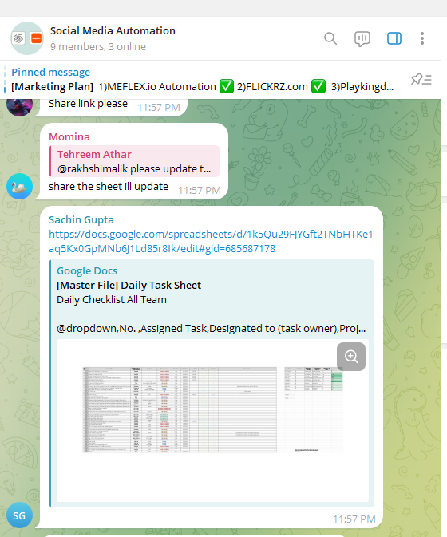
1. Let's learn how to connect with Make.com or order to automatic setting with automation team
1. Ask to automation team to connect each automation
1) Automation team link (you can join and ask them)
https://t.me/+Dc5TRV5VIUcwZTRl
2) Using this link , you can join this group and request them about the automation
[Materials]
Social ID,PW from Documenters or Accounting team
- Snovacapital - Daniyal and Mubashir
- SOMI - Farooq
- Flickrz - Faryal
- Meflex - Abdullah
- Findex - Muarij
And etc
3) If you got the estimation (budget and term) from experts(freelance), you can ask to HR or Accounting team (from our teammate contact telegram, you can find and you can ask him/her about pay for that development fee)
Example
1)DSS (Internal notification)
2)Daily project Notification (External notification for our clients)

Slide 4
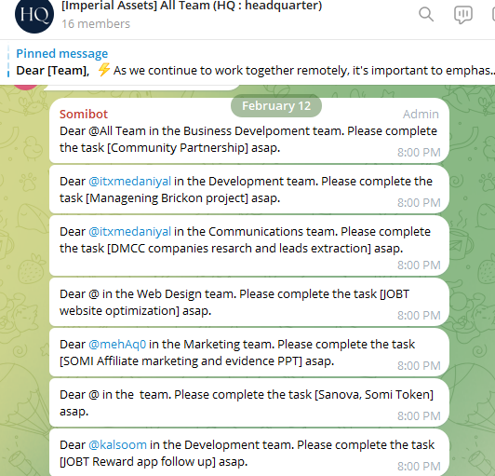
2. we have to set these notification process to client
Example
In case of Internal notification
In case of internal designation for task owner, we can alert every morning.
Like this, we should make sure the notification every morning to our client.
What we have to do for external notification
(To do list, due time, fixed time, updated notification)

Slide 5
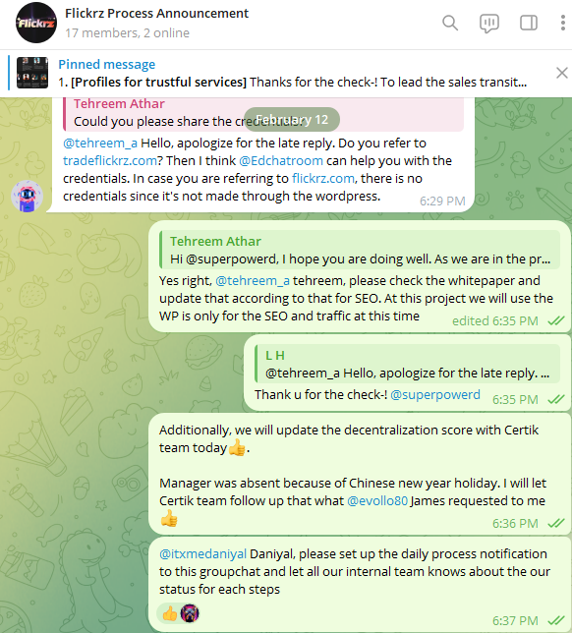
3. please announce current process to client with any kind of info
Example announcement
Today, we’ll finish the marketing for
Daily Routine to check the automated Sales
1)social media posting automation (Using the make.com)
2)replies (you can search on the google for auto DM)
3)likes (you can search on the google for auto DM)
4)Following (you can search on the google for auto DM)
5)Auto DM (you can search on the google for auto DM)
(Instagram, Facebook, Linkedin,
6)video creations : Next pages (Attachment) (Important)
7)Landing page design (Important)
8)Set FB Ads, Google Ads, Linkedin Sponsorship marketing, Instagram Sponsorship marketing, Exclusive FB Group are so profitable to do marketing specific product or service.
9)Inbound process we’ll finish for this today
(QnA for each case) (Ex. (Main Business) Finance service, Marketing Consultation, Shopping mall Product)
QnA sampling in case of chatting

Slide 6
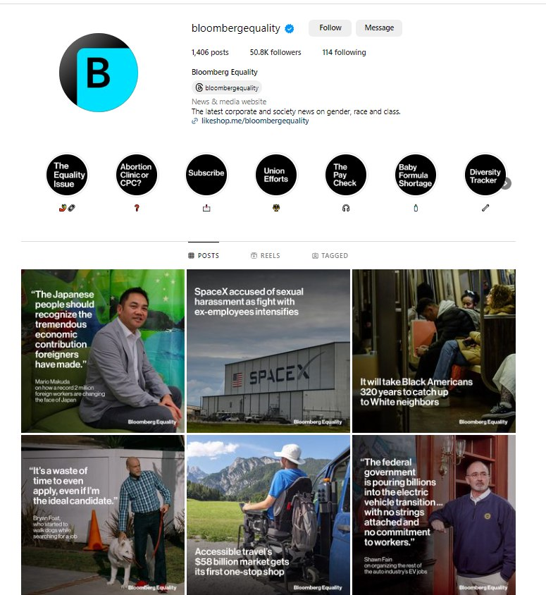
3. please announce current process to client with any kind of info
Remember-! Put the Public info with celebrity images according to RSS policy
for media for public information which release on media previously, we can release them according to RSS policy. Please make the design according to
[Topic of Snovacapital social media]
1) FED USA https://www.federalreserve.gov/
2) Stock Market (you can search on the google or chat GPT)
3) bond market (you can search on the google or chat GPT)
4) blockchain market (you can search on the google or chat GPT)
5) any other economic topics (you can search on the google or chat GPT)
RSS policy (how public info can be opened to every single media?) reference (for public info)
https://en.wikipedia.org/wiki/Media_RSS
Put the inbound system on every single website

Slide 7
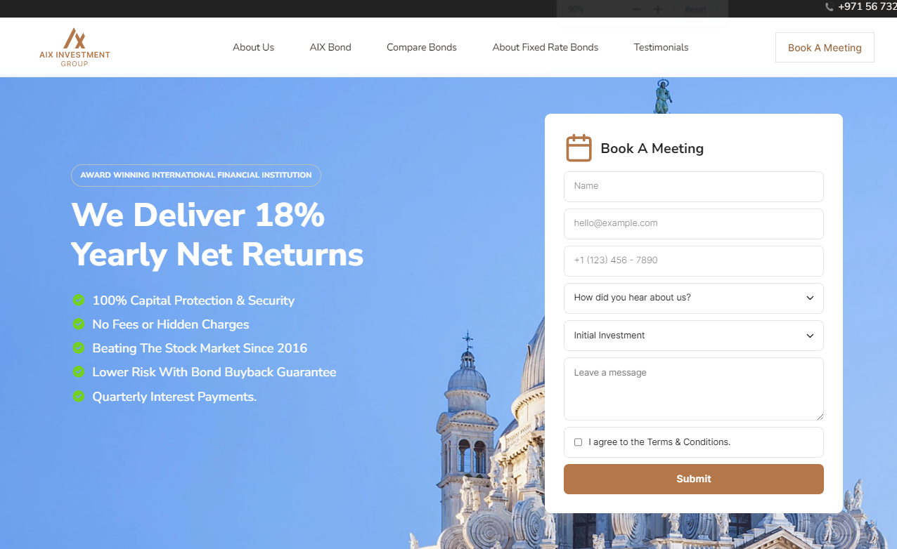
3. please announce current process to client with any kind of info
Remember-! Marketing funnel is important
Put the inbound system on every single website
Snovacapital is similar to this service
https://bond.aixinvestors.com/

Slide 8
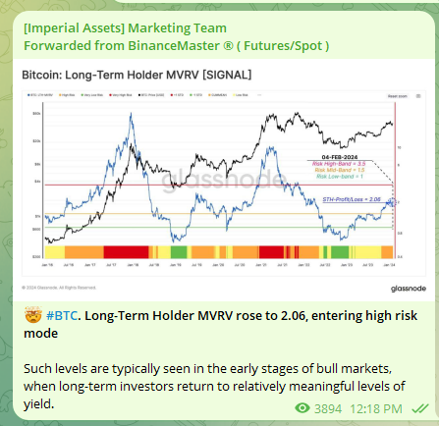
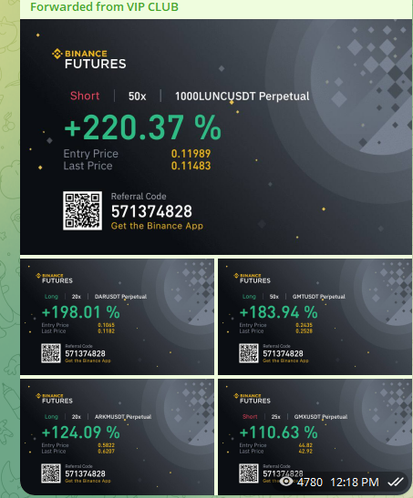
3. please announce current process to client with any kind of info
Remember-! Marketing funnel is important
Put the inbound system on every single website
Snovacapital is similar to this service
https://bond.aixinvestors.com/

Slide 9
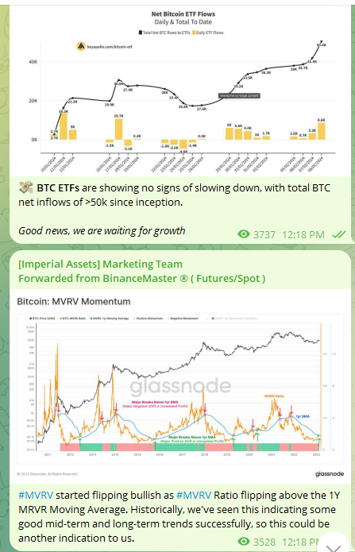
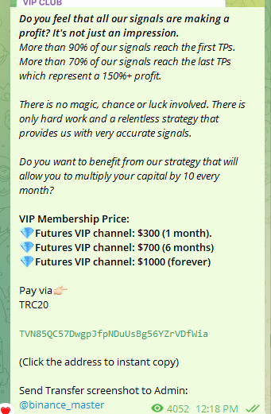
3. please announce current process to client with any kind of info
Remember-! Marketing funnel is important
Put the inbound system on every single website
Snovacapital is similar to this service
https://bond.aixinvestors.com/

Slide 10
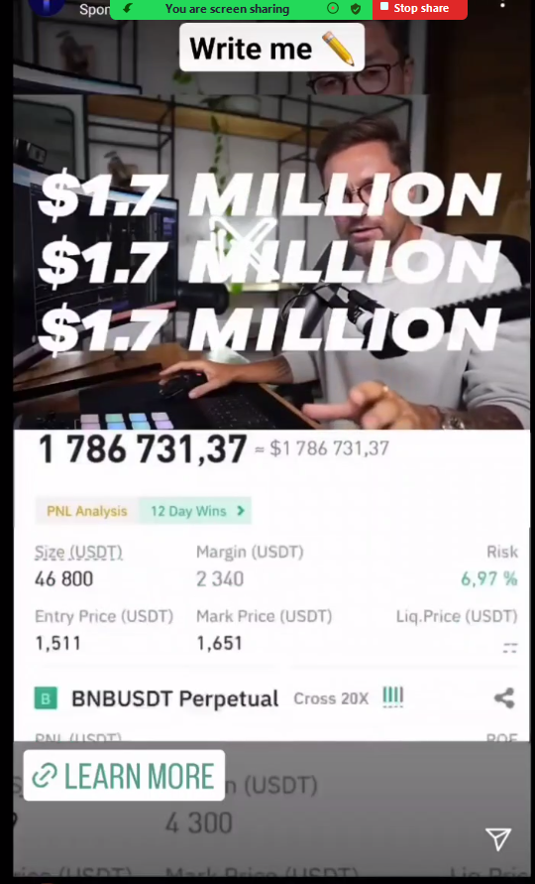
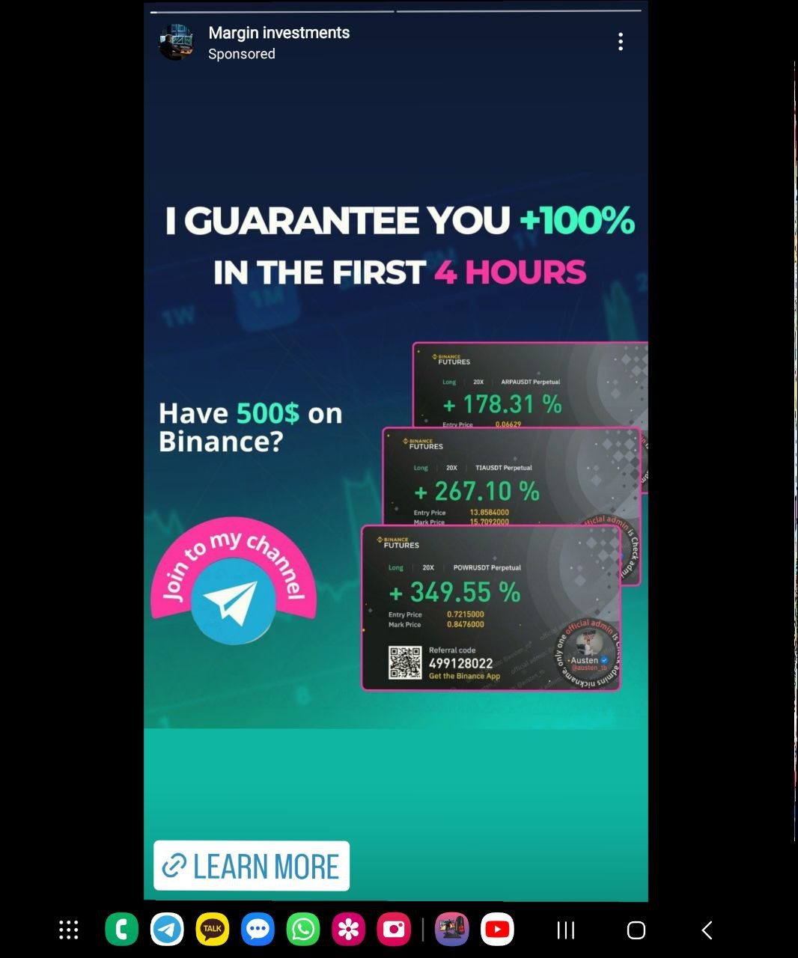
3. please announce current process to client with any kind of info
Remember-! Marketing funnel is important
Put the inbound system on every single website
Snovacapital is similar to this service
https://bond.aixinvestors.com/

Slide 11
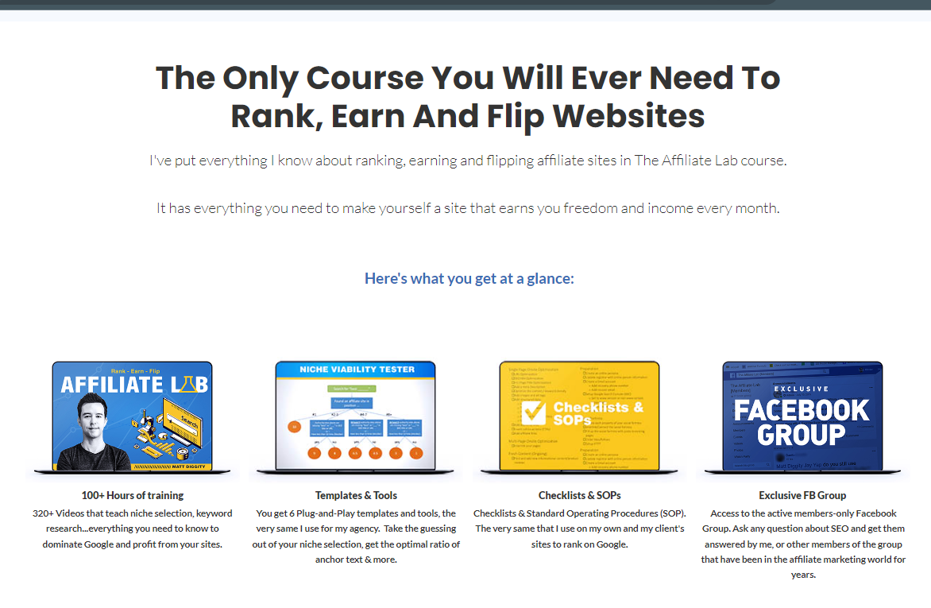
3. please announce current process to client with any kind of info
Remember-! Marketing funnel is important
Put the inbound system on every single website
Snovacapital is similar to this service
https://bond.aixinvestors.com/

Slide 12
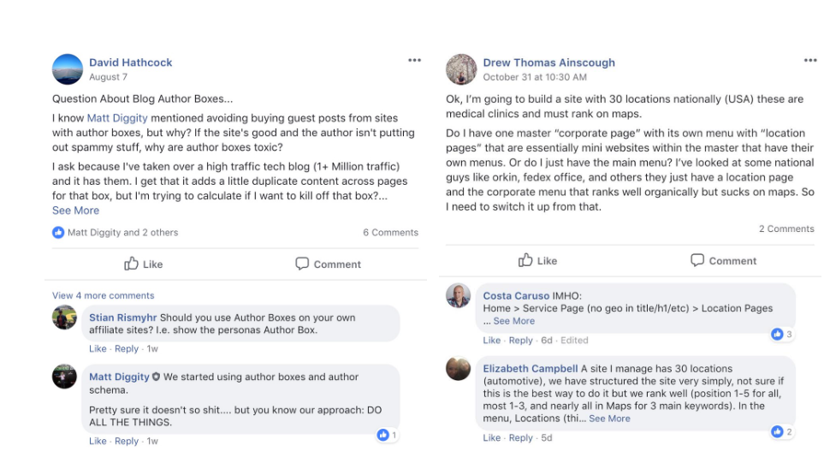
3. please announce current process to client with any kind of info
Remember-! Marketing funnel is important
Put the inbound system on every single website
Snovacapital is similar to this service
https://bond.aixinvestors.com/

Slide 13
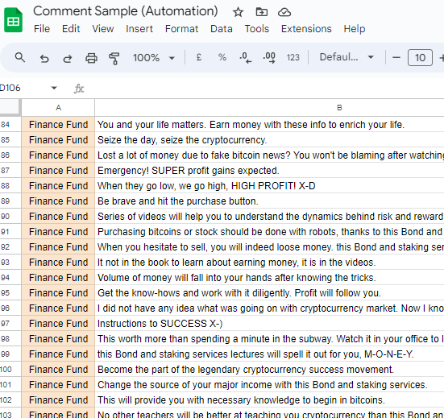
3. please announce current process to client with any kind of info
Remember-! Marketing funnel is important
Put the inbound system on every single website
We prepare the Auto DM System
https://docs.google.com/spreadsheets/d/1bL9F_fARebfPd6DPThMOWfeNTvjileyuWF4cOr485mQ/edit?usp=sharing

Slide 14
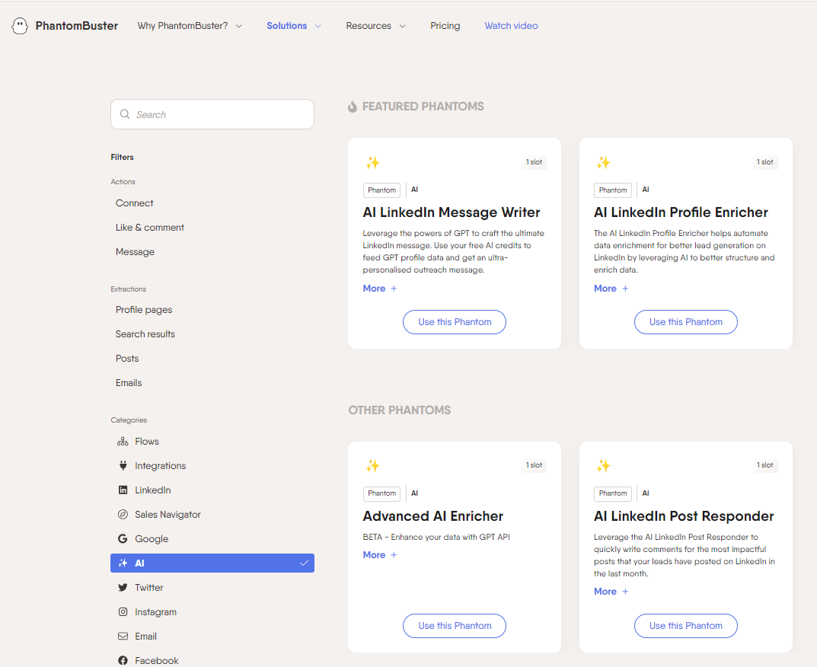
3. please announce current process to client with any kind of info
Remember-! Marketing funnel is important
Put the inbound system on every single website
We prepare the Auto DM System
https://phantombuster.com/phantombuster?category=ai

Slide 15
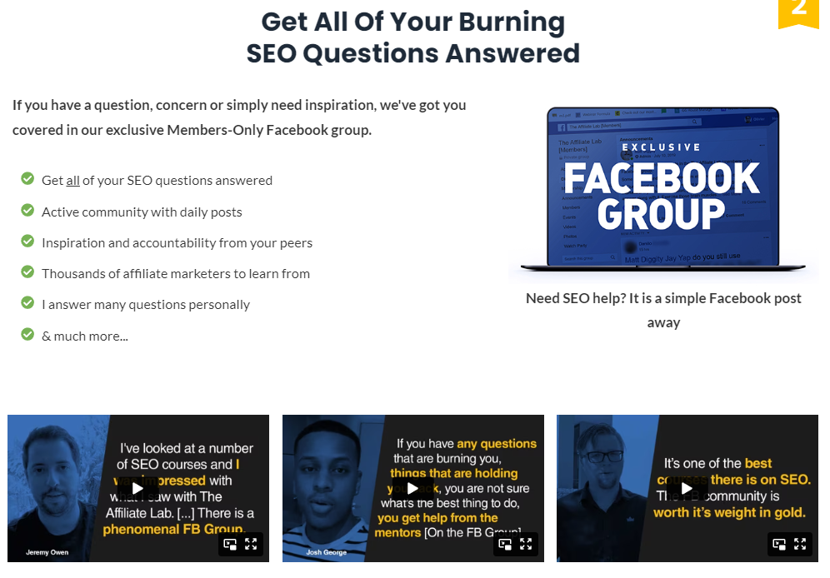
3. please announce current process to client with any kind of info
Remember-! Marketing funnel is important
Put the inbound system on every single website
Snovacapital is similar to this service
https://bond.aixinvestors.com/

Slide 16
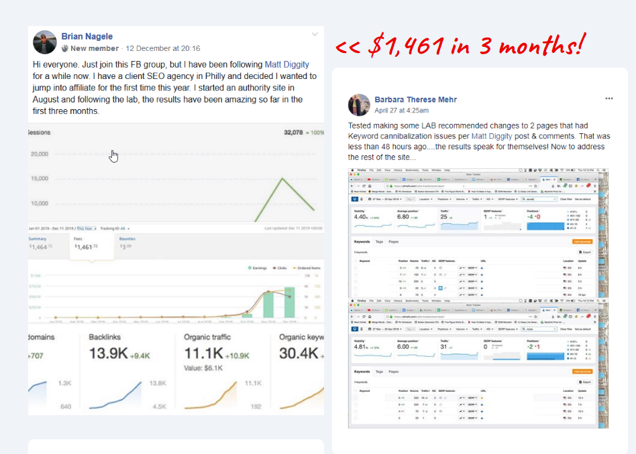
3. please announce current process to client with any kind of info
Remember-! Marketing funnel is important
Put the inbound system on every single website
Snovacapital is similar to this service
https://bond.aixinvestors.com/

Slide 17
2. From today, we have to set these notification process to client
Example
In case of Internal notification
In case of internal designation for task owner, we can alert every morning.
Like this, we should make sure the notification every morning to our client.
What we have to do for external notification
(To do list, due time, fixed time, updated notification)
Requirements and Process announcement (you have
(Before clock out every day, you have to type on automatic announcement sheet in Google Spreadsheet for your task, and discuss with automation team)
1) Design
2) Development
3) Sales
4) Registration
5) Interview
6) Communication
7) QnA for Client KYC

Slide 18
6)video creations : Next pages (Attachment) (Important)
Summary (Memorize that)
D,M, BD team OJT title : How to compose the Marketing landing page image and video orders with review
1. attraction summary of service( finance, marketing or service) to emphasize about the profit after using this service
https://createstudio.com/index.html
Guide
https://youtu.be/GG-9OCKBIBE?feature=shared
[Use the Steve AI for all types of video creation.
(Only youtubers they can create separately for youtubers only)
Otherwise we normally use this app
https://app.steve.ai/
https://app.steve.ai/pricing
2. review(real person video) x 5 times
https://www.canva.com/features/ai-face-generator/
www.Billo.app
3. logo (featured by, partnered by, referred by) for credits (Ex. Tesla, Fiverr, Dropbox and etc) (Ex.Bloomberg, Apnews , Yahoo and etc)
- services description with mechanical image(software images : Google Ads, SEO S/W, Facebook pages, any admin pages, Multi level marketing system and all) Don't forget, people love the professional software to use or invest
https://www.deepbrain.io/
https://www.synthesia.io/
- Price table 3 cases( ☆ Discount, Single Product, Double product, Package product, 5 mins time limit for D/C). (monthly/ Annual (40% Discount)

Slide 19
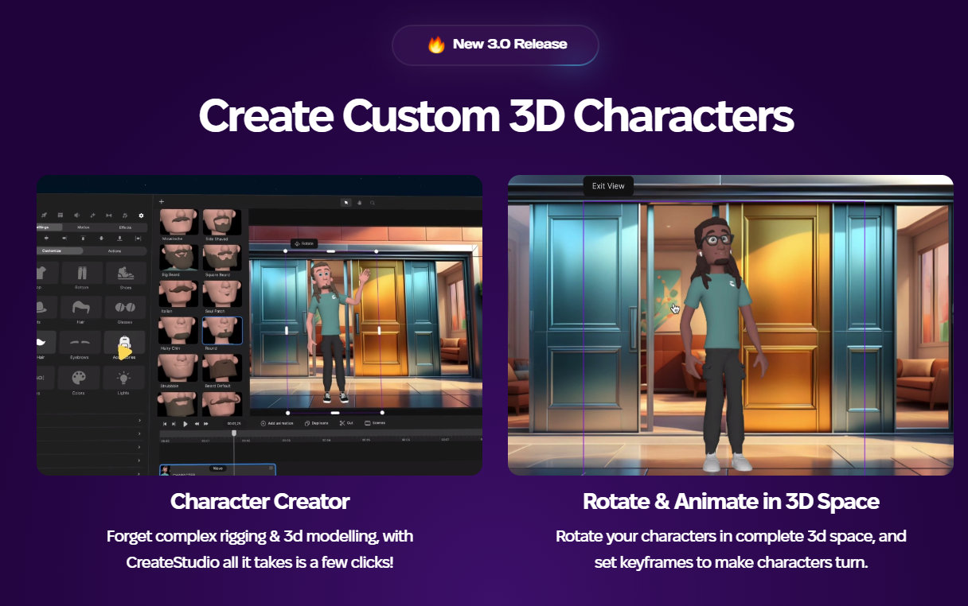
6)video creations : Next pages (Attachment) (Important)
1. attraction summary of service( finance, marketing or service) to emphasize about the profit after using this service
https://createstudio.com/index.html
Guide
https://youtu.be/GG-9OCKBIBE?feature=shared
[Use the Steve AI for all types of video creation.
(Only youtubers they can create separately for youtubers only)
Otherwise we normally use this app
https://app.steve.ai/
https://app.steve.ai/pricing

Slide 20
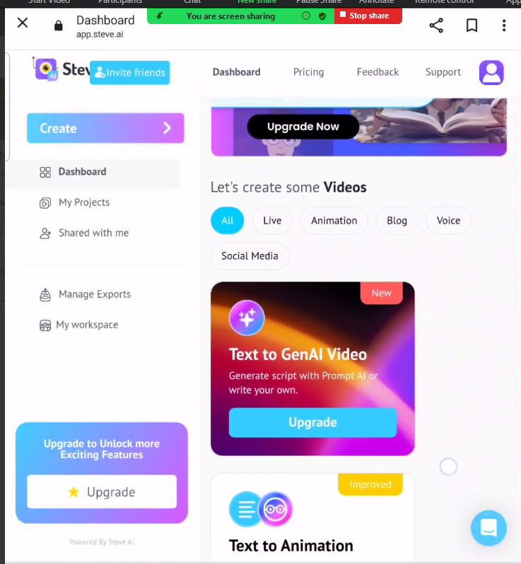
6)video creations : Next pages (Attachment) (Important)
1. attraction summary of service( finance, marketing or service) to emphasize about the profit after using this service
https://createstudio.com/index.html
Guide
https://youtu.be/GG-9OCKBIBE?feature=shared
[Use the Steve AI for all types of video creation.
(Only youtubers they can create separately for youtubers only) (Please get the ID, PW from HR team or Accounting team and create the contents it takes only 5-30 mins (max 1 hr) to make the design and videos)
Otherwise we normally use this app
https://app.steve.ai/
https://app.steve.ai/pricing

Slide 21
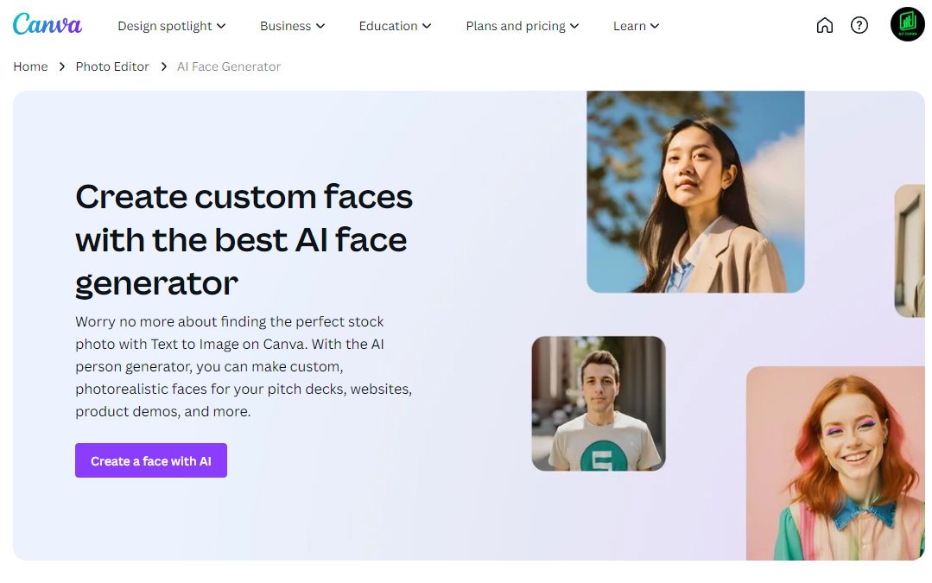
6)video creations : Next pages (Attachment) (Important)
2. review(real person video) x 5 times
https://www.canva.com/features/ai-face-generator/
www.Billo.app
3. logo (featured by, partnered by, referred by) for credits (Ex. Tesla, Fiverr, Dropbox and etc) (Ex.Bloomberg, Apnews , Yahoo and etc)
- services description with mechanical image(software images : Google Ads, SEO S/W, Facebook pages, any admin pages, Multi level marketing system and all) Don't forget, people love the professional software to use or invest
https://www.deepbrain.io/
https://www.synthesia.io/
- Price table 3 cases( ☆ Discount, Single Product, Double product, Package product, 5 mins time limit for D/C). (monthly/ Annual (40% Discount)

Slide 22
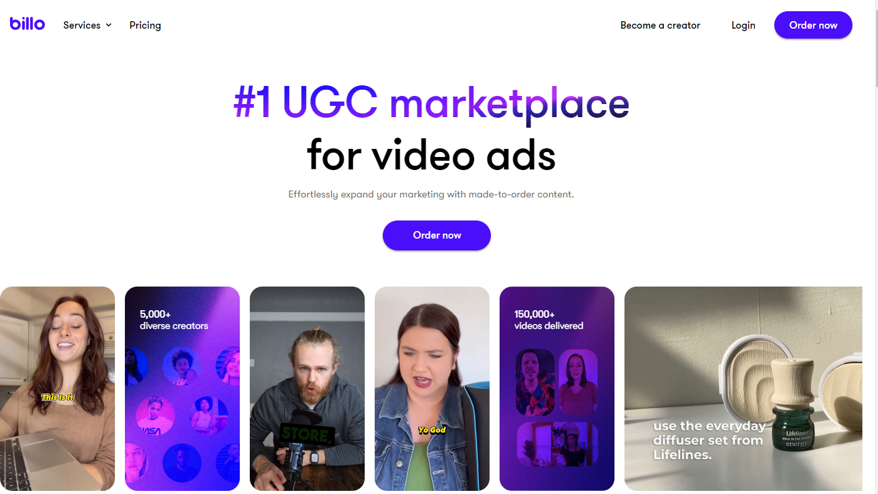
6)video creations : Next pages (Attachment) (Important)
2. review(real person video) x 5 times
https://www.canva.com/features/ai-face-generator/
www.Billo.app
3. logo (featured by, partnered by, referred by) for credits (Ex. Tesla, Fiverr, Dropbox and etc) (Ex.Bloomberg, Apnews , Yahoo and etc)
- services description with mechanical image(software images : Google Ads, SEO S/W, Facebook pages, any admin pages, Multi level marketing system and all) Don't forget, people love the professional software to use or invest
https://www.deepbrain.io/
https://www.synthesia.io/
- Price table 3 cases( ☆ Discount, Single Product, Double product, Package product, 5 mins time limit for D/C). (monthly/ Annual (40% Discount)

Slide 23
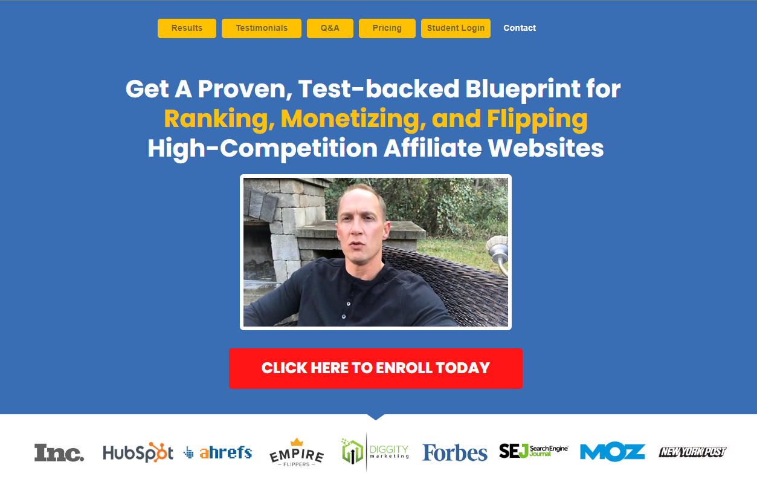
7)Landing page design (Important)
To do list landing page design
(Every single BD team manager, should design for every single design as much as you can using canva.com)
Auditors designation required for each manager 1 of each
[To do list samples]
1) Snova
2) Flickrz
3) Somi
4) Findex
5) meflex
6) usbt
7) bit copier (Thursday) let's do design in zoom)
Due time
(Tuesday)
You can guide them about canva.com tomorrow for BD team with zoom,@BushraBatool5 Bushra with @tehreem_a tehreemsl's marketing guide
https://affiliatelab.im/?utm_source=facebook&utm_medium=cpc&utm_campaign=Purchase+%7C+Prospecting+%7C+All+GEO+%7C+ABO&utm_term=WW+%7C+Interest+%7C+Purchase+%7C+Website+platforms+%E2%80%93+Copy&utm_content=120205536282290518

Slide 24
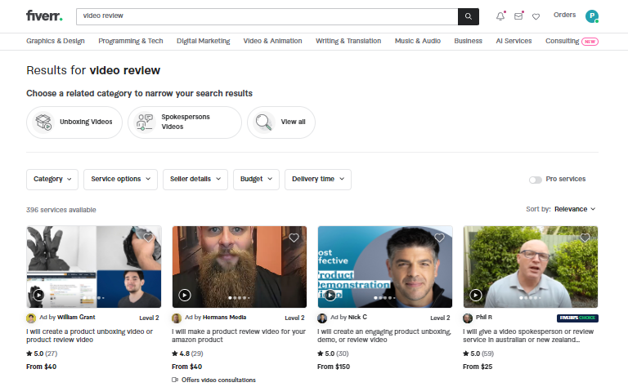
7)Landing page design (Important)
Go to Fiverr and Hire reviewer
Using our company ID, PW for fiverr.com platforms, you can hire them 1 of each. We already registered our card info for each freelancers
[Marketing expenses for sure and persuade people to promote service or product]
Make sure at least 10 reviews for each product. And guide them why each product is innovative. (why this product is profitable for you, Didn’t you feel uncomfortable before when do OOO?, its really wonderful solution for your OOO)

Slide 25
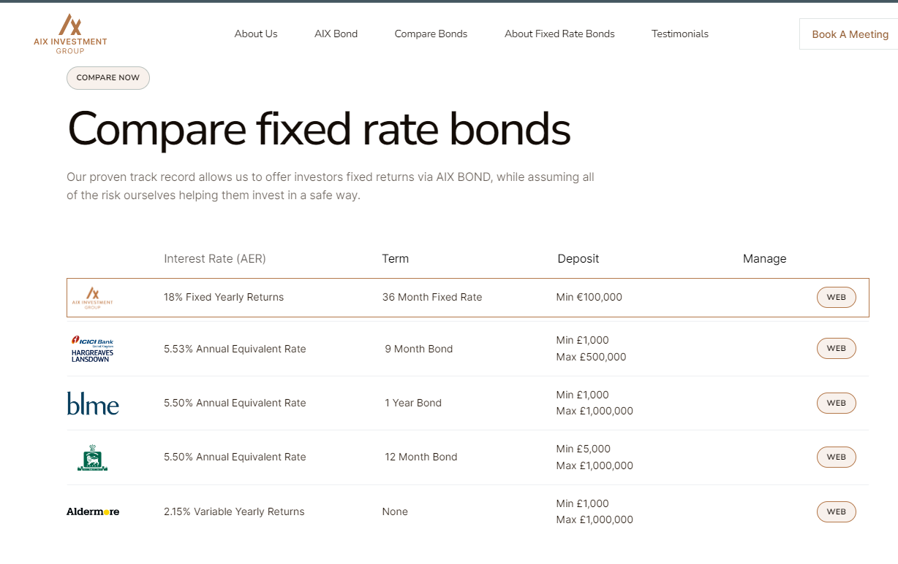
7)Landing page design (Important)
To do list landing page design
(Every single BD team manager, should design for every single design as much as you can using canva.com)
Auditors designation required for each manager 1 of each
[To do list samples]
1) Snova
2) Flickrz
3) Somi
4) Findex
5) meflex
6) usbt
7) bit copier (Thursday) let's do design in zoom)
Due time
(Tuesday)
You can guide them about canva.com tomorrow for BD team with zoom,@BushraBatool5 Bushra with @tehreem_a tehreemsl's marketing guide
https://bond.aixinvestors.com/ (sample)

Slide 26
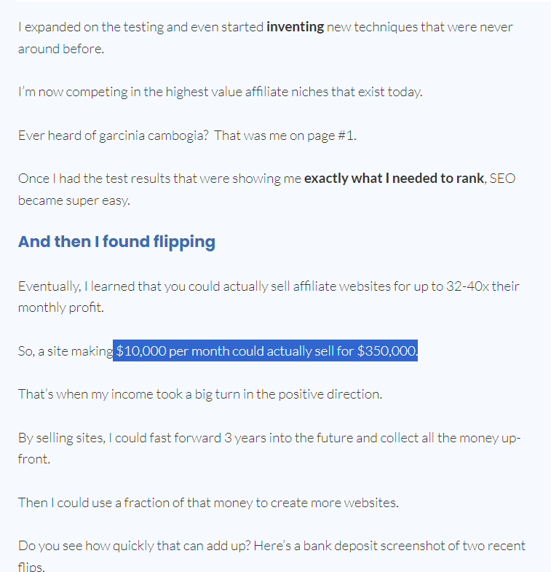
7)Landing page design (Important)
Don’t forget to mention about advantage with numbers.
(Growth or Profits)
https://affiliatelab.im/?utm_source=facebook&utm_medium=cpc&utm_campaign=Purchase+%7C+Prospecting+%7C+All+GEO+%7C+ABO&utm_term=WW+%7C+Interest+%7C+Purchase+%7C+Website+platforms+%E2%80%93+Copy&utm_content=120205536282290518

Slide 27
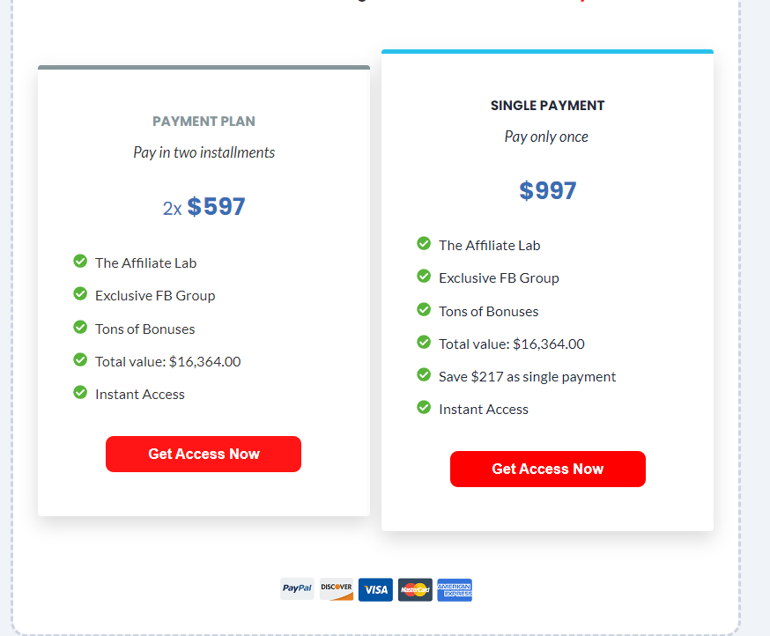
7)Landing page design (Important)
Don’t make 2 price table. Please make 3 types of price table
[3 types]
-Economy
-Recommended
-Full Package
[You can create price contents with various types of idea]
Please create the each service package by Finance Investment service by searching and comparing to competitors in market.
https://affiliatelab.im/?utm_source=facebook&utm_medium=cpc&utm_campaign=Purchase+%7C+Prospecting+%7C+All+GEO+%7C+ABO&utm_term=WW+%7C+Interest+%7C+Purchase+%7C+Website+platforms+%E2%80%93+Copy&utm_content=120205536282290518

Slide 28
7)Landing page design (Important)
Example
Additionally, at the price table, you can create the sample price table for new customer
Welcome to partnerscan
1.Attraction contents : You can do partnership from 30 USD for each project.
2.please fill in detail your project
name, job title, email, project logo file, blockchain field, project website, social media
(After they filled in, show following list for each estimation at 1 single popup and let them proceed the pay for 375 usd)
(Usd = Usdt)
Use thin plugin
https://wordpress.org/plugins/cryptopay-wc-lite/
They can pay for using Bitcoin, Ethereum or etch token using this plugin.

Slide 29
7)Landing page design (Important)
Example
To suggest to pay for partnership service, we will show (partnership contact service) product details at woocommerce product page
[Woocommerce total payment]
1st Package (1 Project)
from 55 USD, you can proceed the Partnership each project
(1)partnership contract issue 95 USD (required * )
(2) airdrop or event contents image generating 95 USD (required * )
(3) sales text generating 55 USD (optional * )
(4) posting info to our dashboard and social media to advertise your service 40 USD (optional * )
(5) PR 190 USD (1 of World Top 10 economic press) (optional * )
(475 usd / 1 project partnership process)
(Users can not purchase separately, users should purchase 1 whole package)

Slide 30
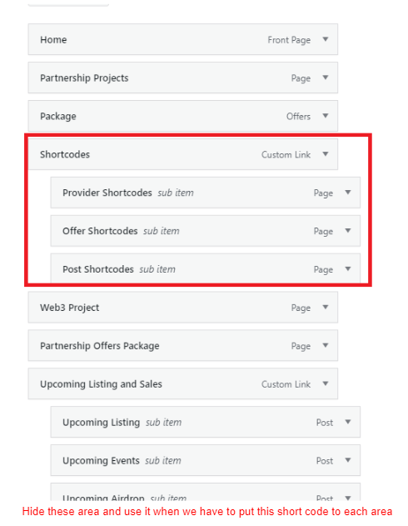
7)Landing page design (Important)
Example
2nd Package (D/C)
[Sales discount]
If they purchase 10 partnerships for blockchain project > 4750 USD > 3380 (20% D/C)
[Referral for Project purchase for woocommerce : 30% reward for purchasing]
https://woo.com/products/referral-system-for-woocommerce/

Slide 31
7)Landing page design (Important)
Let’s Practice
(We will take an exam with test. So memorize all process as much as you can)
1. [All team OJT] How to create the sample design video tutorial
https://drive.google.com/drive/folders/1hDrigwqCblIOgz9jlJ8PTbOrorPY0KYM
2.[All team OJT] how to make the proposal(IR, Documentation) video tutorial
https://drive.google.com/drive/folders/1tLWK6qDTKSU8P5JDHRRCnDzH4tpnoB9M
3. [all team OJT] how to create the Whitepaper and social media. And raise the followers or followings
https://drive.google.com/drive/folders/1swg0ogIm9N4s1QDEIp-nEFy11ZgtkT0h
4. [All teams OJT] make a posting image in 20 mins 6 postings
https://drive.google.com/drive/folders/1n0fiAyqGjgp8AnlvPCDlow_m7hQyVtzO
5.Economic service marketing strategy (Korean > English needed)
https://docs.google.com/document/d/1wnNKlpzVwVQIV92CrQqxGIRmVqTyoTtFCZqQe9cnB2g/edit?usp=drivesdk
6. Conversation sample
https://docs.google.com/document/d/1GIon2YLql-9QxVT1TozRNJf_LhJbGaIC3BOYvEhRBm4/edit?usp=drivesdk

Slide 32
7)Landing page design (Important)
Let’s Practice
7. Auto TG bot maker
https://docs.google.com/document/d/1HH4sE-iHeqhrnm1s9efwgInmoU3m_zMmwTqTiiut86A/edit?usp=drivesdk
Inbound
https://www.sociallyk.com
buzzvoice.com
buzzoid.com
Outbound
Auto DM bot or Comment bot
https://phantombuster.com/7473395921122066/phantoms?returnTo=%2Fautomations%2Finstagram%2F14303%2Finstagram-auto-commenter
it should be real person review (such as youtuber or any influencers video)
1) Not Asset such as any other open source like https://billo.app/
2) if you can not make the video, you can make the review for users using AI for multilingual contents
https://www.rask.ai/

Slide 33
7)Landing page design (Important)
After you set the landing page design + Price table 3 set, you can learn wordpress from now on. Let’s see at the next lecture-!

Slide 34
BD, D, M, C team
Sales Procedures (Daily Routine)
snovacapital.com

